Slide 1
Using the TI NspireTM NavigatorTM to Promote Student Success
Valerie Hudson
Texas Instruments Instructor
817-455-2269
vhudsonmath@gmail.com

Slide 2
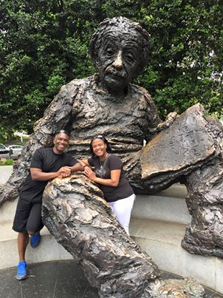
Education is not the learning of facts, but the training of the mind to think. Albert Einstein

Slide 3
Logging in to the TI Navigator System
Log in: Turn Calculator on, then:
Press 5: Settings 5: Login
Type the user name at the top of the yellow “hat” (Not case sensitive)
Type the password at the top of the yellow “hat”
Answer the question that appears
Send your answer: “Doc” “1”
3

Slide 4
TI Nspire Overview
Formative Assessment—Quick Polls
Formative Assessment—Class Capture
Engaging students with problem solving activities
Differentiating Instruction with Navigator
Student Self Check Feature
Grading with Navigator
education.ti.com Resources
Agenda
4

Slide 5
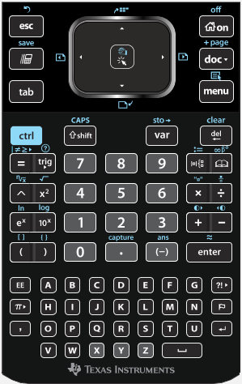
Escape
Home
ScratchPad
Document
Tab
Menu
Control
Backspace
Shift
Computer Like Keys
Notes:
Main Goal: Know that the TI-Nspire is in many ways like a computer. The green keys are not exactly like keys on a keyboard, but Doc and Menu can be compared to the toolbar options you get in programs like Powerpoint or Word. The icon above Menu is found on computer keyboards. It is the right-click or contextual menu button.
After you have pressed ScratchPad or are in a document, ask “What does Home remind you of?” Ans: Desktop.
You cannot access DOC from the home screen, but you can from the Scratchpad. Press Scratchpad once so you can see the options that are there. Hey, what happens if you press Scratchpad a second time?
A common question that often arises early in the usage is how to turn caps lock off. Notice the blue word above Shift.
Many people get really excited when they notice the icon above ESC. Yes, the TI-Nspire does UNDO. This can also be accessed from ctrl-Z just like on a computer.

Slide 6
The TI-NspireTM CX NavigatorTM Classroom
Notes:
Teacher software

Slide 7
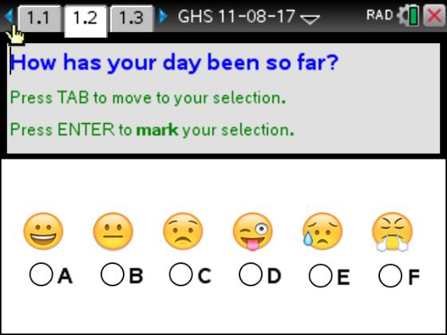
Quick Poll
Notes:
Emoji Quick Poll
Participants send responses by pressing “Doc” “1”

Slide 8
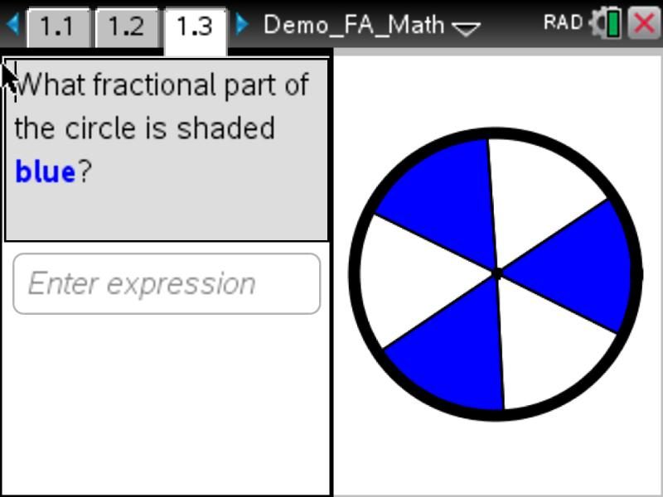
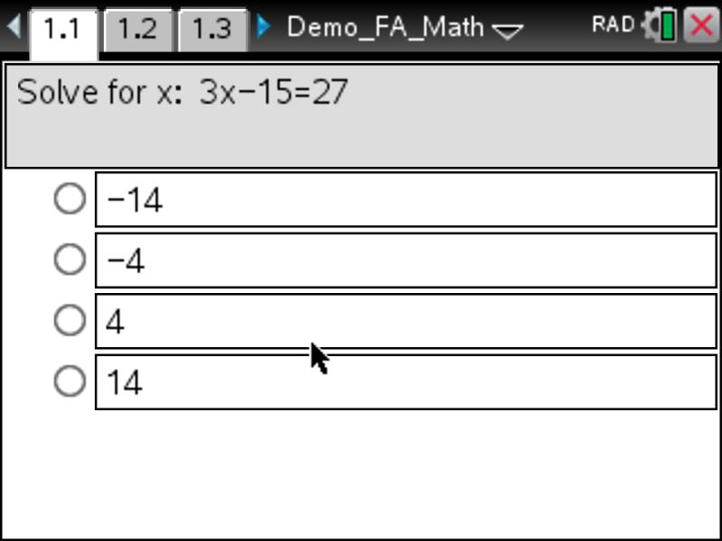
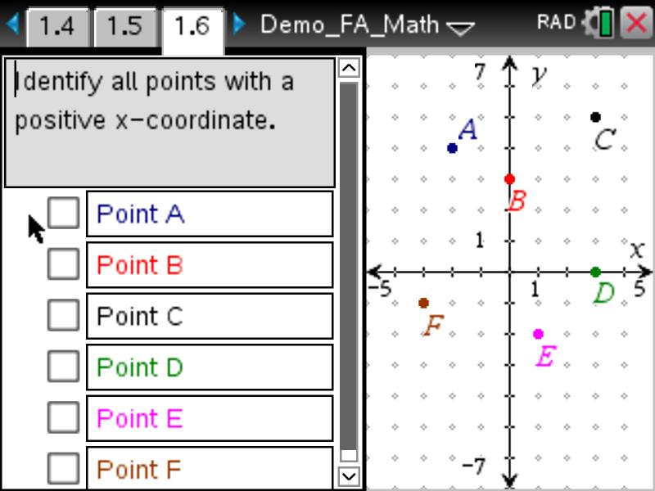
Questioning and Question Types
8
Notes:
Varied question types.
Engage students in discussion regarding why they choose the answers that they pick.

Slide 9
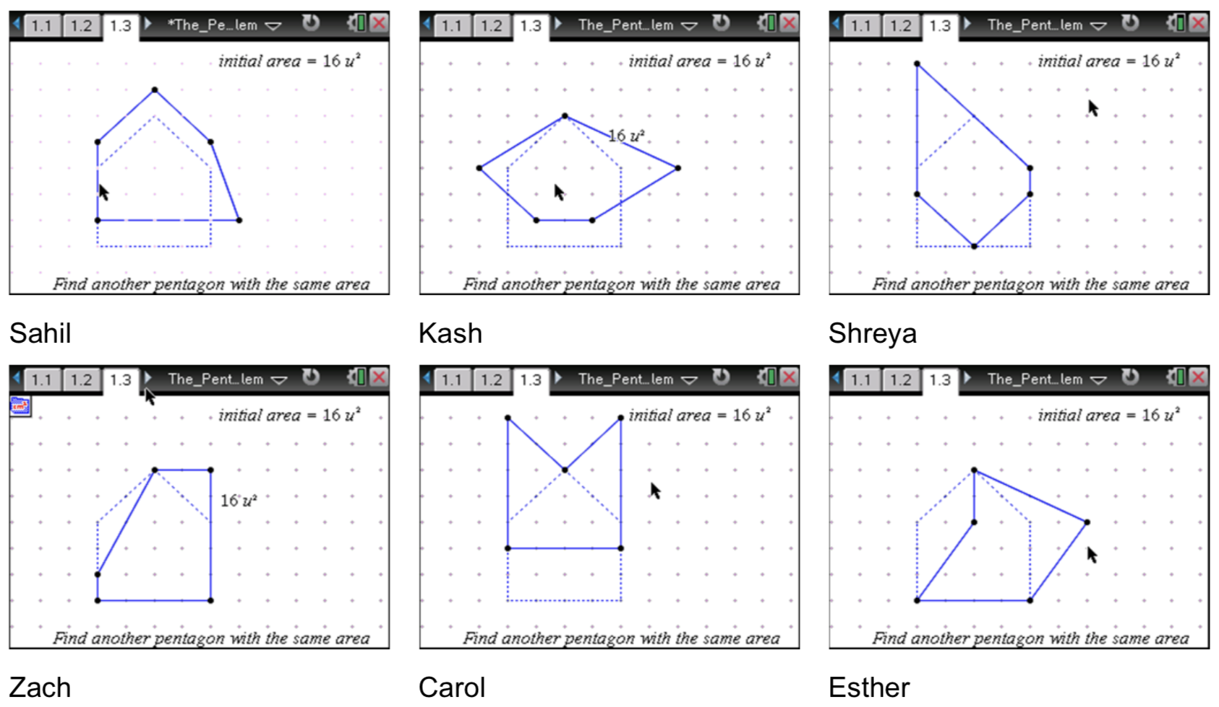
Class Capture Feature
Notes:
What benefits does the use of the Auto-Refresh feature of Class Capture provide when students are working on an assessment or any other assignments?

Slide 10
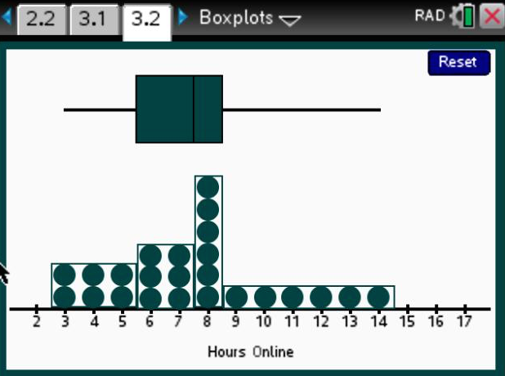
Problem Solving Activities

Slide 11
Activity: Growing Patterns
Patterns are generated in order to count and record the number of tiles needed to form the figures.
Investigate the perimeters of figures at various stages in the pattern.
Notes:
What kind of formative assessment(s) could be used in this activity?

Slide 12
Differentiating Instruction—Student Self-Check
End of class “Ticket Out”
Notes:
What kind of formative assessment(s) could be used in this activity?

Slide 13
Differentiating Instruction--Lesson Snippet: Algebra 1
Discussion
What was the content of the lesson?
What tools were used to assess the lesson?
How did the teacher modify the lesson?
How could the teacher modify the lesson?
What other assessment tools might be used?
13

Slide 14
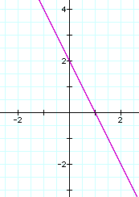
What is the slope of the graph?

Slide 15
Which ski slope is steeper?
A
B

Slide 16
Find the slope of a line containing the points (4, 2) and (2, 1).
m = 1/2
Find the slope of a line containing the points (2, 3) and (4, 6).
m = 3/2

Slide 17
Which is more likely?
The slope of A is 1/2 and the slope of B is 3/2.
The slope of A is 3/2 and the slope of B is 1/2.
A
B

Slide 18
If L2 = 3x + 5, then
L1 = 2x + 5
L1 = 3x + 5
L1 = 4x + 5

Slide 19
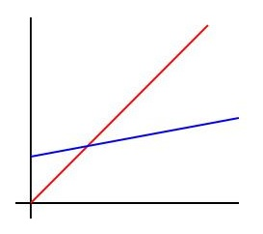
Which statement must be true?
A.
B.
C.

Slide 20
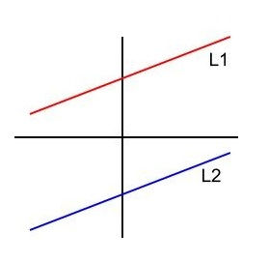
If L2 = x – 4, then A. L1 = x – 4 B. L1 = x + 4 C. L1 = x

Slide 21
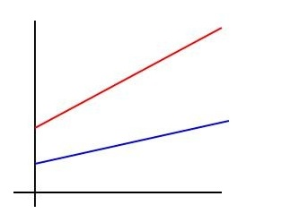
Which statement must be true?
A.
B.
C.

Slide 22
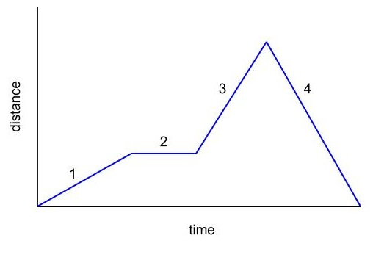

Slide 23
Differentiating Instruction--Lesson Snippet: Algebra 1
Discussion
What was the content of the lesson?
What tools were used to assess the lesson?
How did the teacher modify the lesson?
How could the teacher modify the lesson?
What other assessment tools might be used?
23

Slide 24
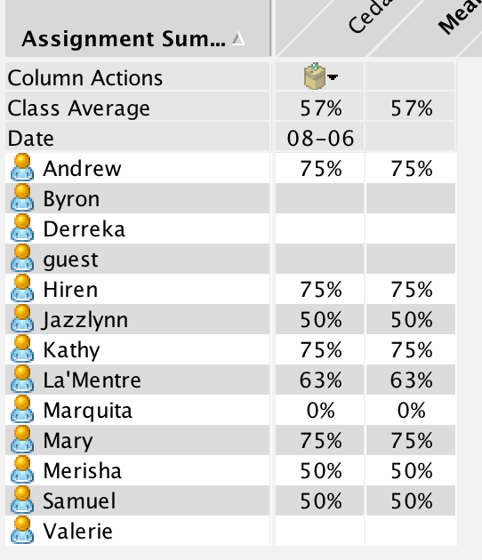
Grading with Navigator--
Portfolio Feature
Notes:
How does the ability to compare a previous assessment of the same concept in the Portfolio enable you to more easily gauge the growth of student?

Slide 25
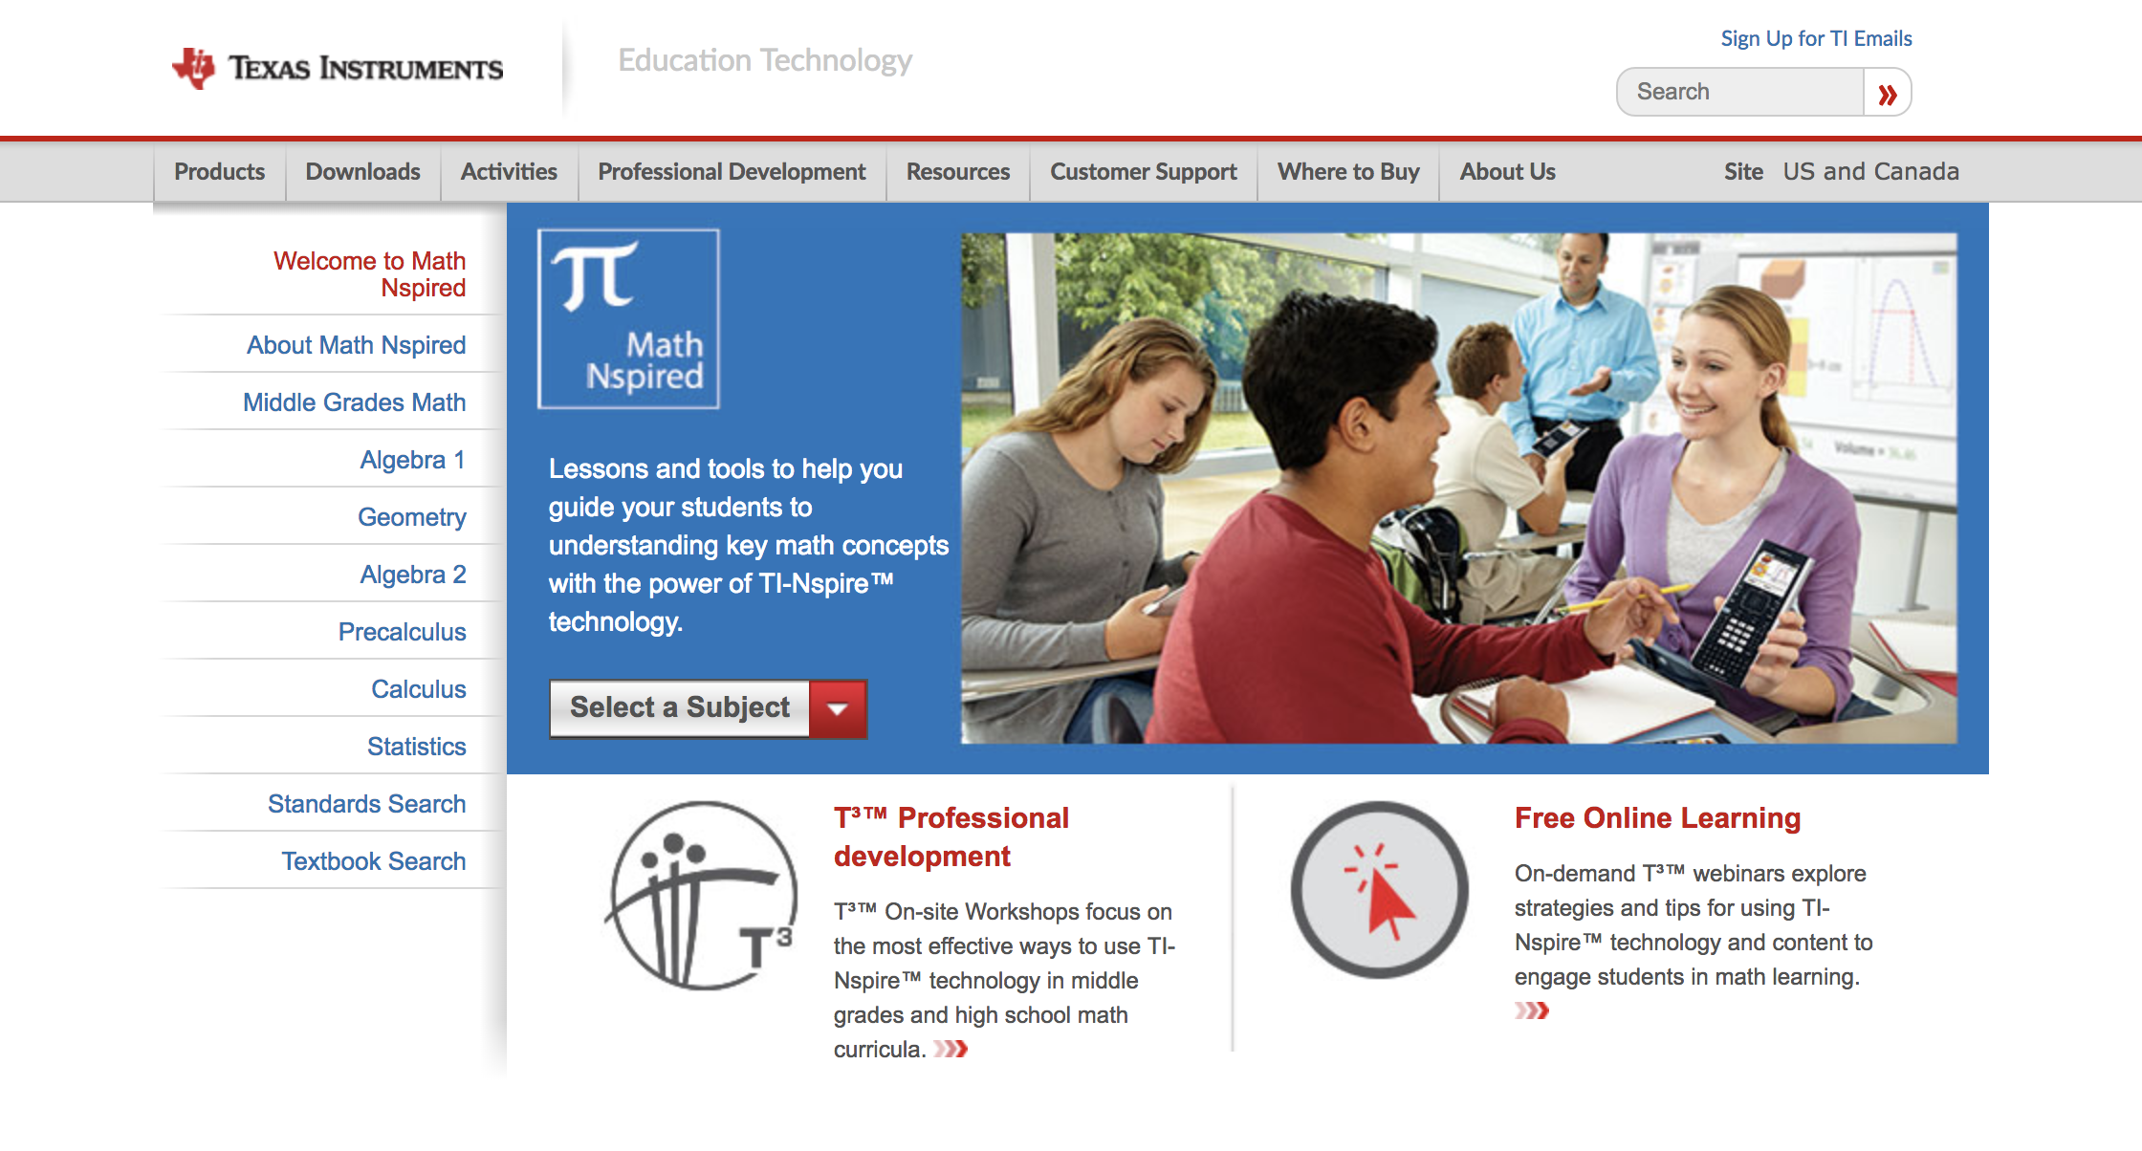
education.ti.com

Slide 26
Q & A

Slide 27
Thank you for a great
learning session!

