Slide 1
Growth Mindset and
Language in Mathematics
Dawn Hoyt Kidd, Ph.D.
Texas School for the Deaf
DeafTEC Mathematics Education Conference
Region XIII - Austin, TX
November 2018

Slide 2
WHO AM I?
Dawn Hoyt Kidd
Originally from Miami, FL
BS from Vanderbilt University
Special Education
MA from University of Texas at Austin
Deaf Education
PhD from University of Texas at Austin
Interdisciplinary Curriculum & Instruction - Math Education, Deaf Education, Bilingual Education, etc.
Currently - Teacher at the Texas School for the Deaf
Have taught MS Mathematics, HS remedial mathematics,
Community College Developmental Mathematics

Slide 3
WHO ARE YOU?
Teachers
Middle School?
High School?
Post-secondary? Community College?
You teach general education classes, and have 1 or more deaf/hh students included in your class?
Your students are deaf/hh and use sign language? (ASL?? SEE?? Other??)
Your students are deaf/hh and do not use sign language?
Admin?
Parent of a deaf/hh student
Other?
Have you attended other DeafTEC workshops? Project Access?

Slide 4
WHAT RESOURCES DO YOU USE?
Textbooks?
Other print materials?
Technology?
Calculators?
Other devices?
Apps?
Other?
Notes:
Good to ask your audience - for those of you who teach math, what resources do you use?

Slide 5
WHAT ARE WE DOING HERE?
Your expectations:

Slide 6
WHAT ARE WE DOING HERE?
My expectations:
Discussion amongst all of us
Questions from the audience
Answers from the audience
Attention to each other
Cell phones & other devices off
Mutual respect
Breaks when needed

Slide 7
WHAT IS IT?
Notes:
How many of you are already familiar with DeafTEC?

Slide 8
Goal: More
Deaf and Hard of Hearing students going into S T E M
fields.
Notes:
Check back on this each time…keep me honest! REMEMBER THIS.

Slide 9
WHO CAN BENEFIT FROM DEAFTEC?
Students
D/HH students
Second language learners
Visual learners
Learners with delayed processing
Parents of these students
Teachers
Specialized Schools
Itinerant Teachers
Mainstream Teachers
Support Staff
Sign Language Interpreters
Classroom aides
Counselors

Slide 10
What is
?

Slide 11
TEN SKILLS YOU NEED TO LAND A STEM JOB
Critical Thinking*
Analytical Skills*
Problem Solving*
Innovation*
Collaboration*
Communication*
Customer Orientation
Adaptability
Social Responsibility
Balance
Seattle Business Magazine, 2013.
Notes:
From your math class to STEM fields, which of these do you cover?

Slide 12
S T E M - MATHEMATICS
Communication:
Reading, Writing, Talking, Signing, Looking, Listening, etc.
Problem Solving
Applying, Analyzing, Questioning, Troubleshooting, etc.
Notes:
So, our part of the picture is the M – mathematics. That is still a big part, so I will focus on just 3 ideas related to the aspects of Problem Solving and Communication. By communication I mean reading, writing, talking, signing, looking, or listening. We all know what problem solving looks like…? Or do we….?
Favorite standard “Communication” (NCTM 1989)
Cross-curricular – Art form, from Paris, France….? Anyone? “the Thinker” by Rodin

Slide 13
Topics
-Growth Mindset
-Number Talks
-Word Problem Analysis Form
-Process Movies - FlipGrid
Rodin’s “The Thinker” 1904
Notes:
Favorite standard “Communication” (NCTM 1989)
Cross-curricular – Art form, from Paris, France….? Anyone? “the Thinker” by Rodin

Slide 14
GROWTH MINDSET
Notes:
Why would we be talking about this now? I wanted to add this piece because: 1. It applies to all topic areas, but especially math, and 2. We mostly work with struggling math learners, and this is very applicable to them.

Slide 15
DO THIS – 5 MINUTES READ CAREFULLY BE HONEST WRITE TOTALS TURN OVER
Notes:
After -so what do you think?

Slide 16
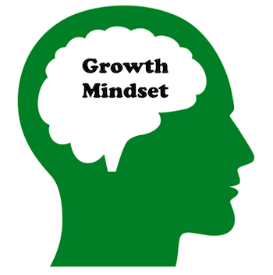
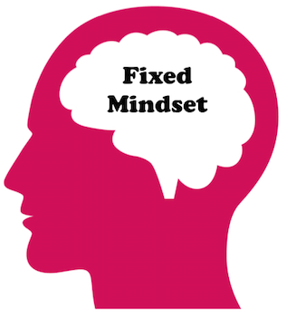
Carol Dweck - Professor of Psychology at Stanford University.
Especially applies to mathematics learning.
Notes:
Starting to get an idea of what the differences are? Discuss if you think they are Growth Mindset or Fixed mindset.

Slide 17
A FEW MORE POINTS …
Struggle and mistakes are OK, and are a normal part of learning.
Radical idea - Not impressive to get work correct – means you were not given the opportunity to learn anything.
Notes:
Watch video at youcubed

Slide 18
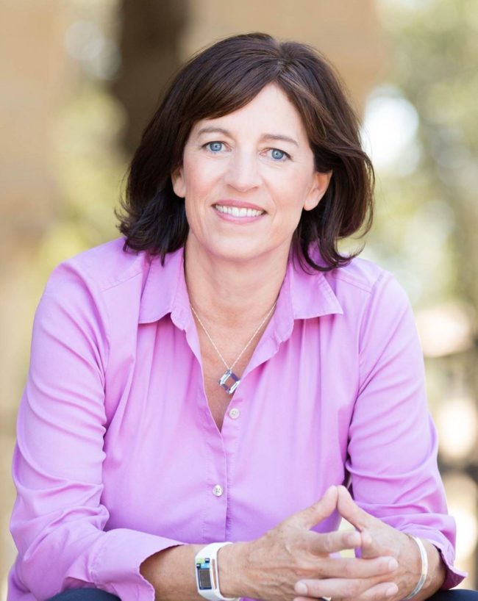
A FEW MORE POINTS ABOUT THIS…
Jo Boaler – professor of Mathematics Education at Stanford University
youcubed
Notes:
Watch video at youcubed

Slide 19
IMPACT OF TEACHER MINDSET
Educators with a fixed mindset about math ability were more likely to judge students as having low potential than their growth-minded counterparts.
Notes:
But we became teachers!! Why would we want to have a low expectation?

Slide 20
IMPACT OF TEACHER MINDSET
Educators with a fixed mindset were more likely to comfort students about their perceived low math abilities and apply kind strategies.

Slide 21
IMPACT OF TEACHER MINDSET
Comfort-oriented feedback – telling students that their inability to succeed at math is OK…
***Linked to lower motivation in students and lower expectations for their own performance.

Slide 22
SO WHAT CAN YOU (THE TEACHER) DO??
Establish high expectations
“This will be a challenging concept to learn, but all of us can reach the goal. I want you to stretch”.
Notes:
Comfortable with what Growth Mindset is? OK Fine, but now what can yu do with it.

Slide 23
SO WHAT CAN YOU DO??
Create a risk-tolerant learning zone.
Ask students to share their “best” mistake of the day/week, and what he/she learned from it

Slide 24
SO WHAT CAN YOU DO??
Give feedback that focuses on process
Praise things like effort, challenge seeking, persistence, good strategies
Don’t praise personal traits or abilities (“smartness”).

Slide 25
Read through these ideas and pick one you might use very soon – DISCUSS with someone.
Notes:
Give 5 minutes - look at this paper

Slide 26
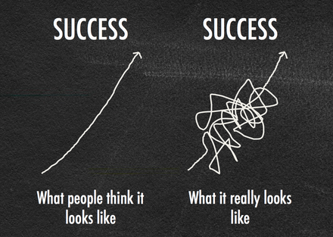
Notes:
Growth Mindset is not just a different way to praise students, but truly a way for us to think about them as learners, and a way for them to think about themselves as learners.
Not just a “think positive” thing.

Slide 27
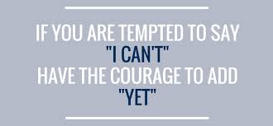

Slide 28
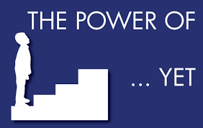

Slide 29
GROWTH MINDSET
Pros? Cons?
Can you see a use for this in your classroom? How? How not?
Will this help achieve our goal? How? Why? Not?
Notes:
After everyone has finished, discussion.
Pros: organizes thinking, multi-modes (numerical, pictoral, written)
Cons: takes time, students struggle with writing,
2 documents – pdf and doc – you can change the doc one to fit your needs.

Slide 30
Notes:
Let’s talk about LANGUAGE. The student population that we are ultimately impacting - what is their language understanding, in general. Deaf & Hard of Hearing students struggle with math. They may have delayed language learning, lower reading levels than their hearing peers, etc.

Slide 31
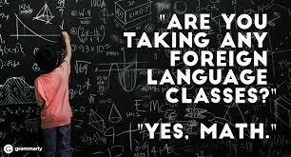
Notes:
Deaf & Hard of Hearing students struggle with math. They may have delayed language learning, lower reading levels than their hearing peers, etc.

Slide 32
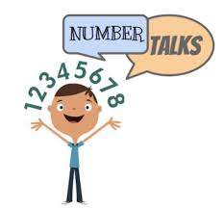

Slide 33
NUMBER TALKS - Let’s do it!
No paper, pencil, calculators, etc.
Fist on chest
Thumb up when you have a solution
Fingers 2, 3, etc. if you have more than one solution.
Respect all talk
Notes:
When possible I group the students in front of me in chairs with no tables.

Slide 34
Without counting, how many dots are there?
Notes:
When possible I group the students in front of me in chairs with no tables.

Slide 35
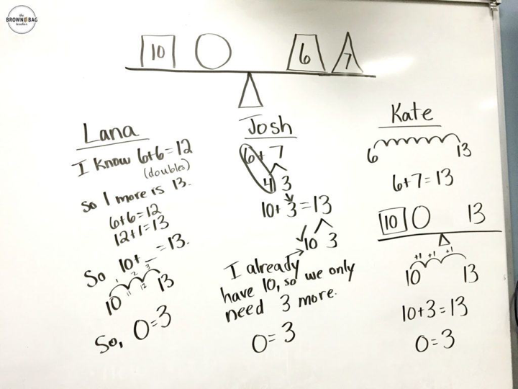
Notes:
When possible I group the students in front of me in chairs with no tables.

Slide 36
Notes:
When possible I group the students in front of me in chairs with no tables.

Slide 37
NUMBER TALKS - What did we do?

Slide 38
NUMBER TALKS - Why would we do them?
Increases student knowledge of number sense and operations.
Encourages language uses at higher levels.
Shows students they can learn from each other and not always just from the teacher.

Slide 39
NUMBER TALKS
Pros? Cons?
Can you see a use for this in your classroom? How? How not?
Will this help achieve our goal? How? Why? Not?
Notes:
After everyone has finished, discussion.
Pros: organizes thinking, multi-modes (numerical, pictoral, written)
Cons: takes time, students struggle with writing,
2 documents – pdf and doc – you can change the doc one to fit your needs.

Slide 40
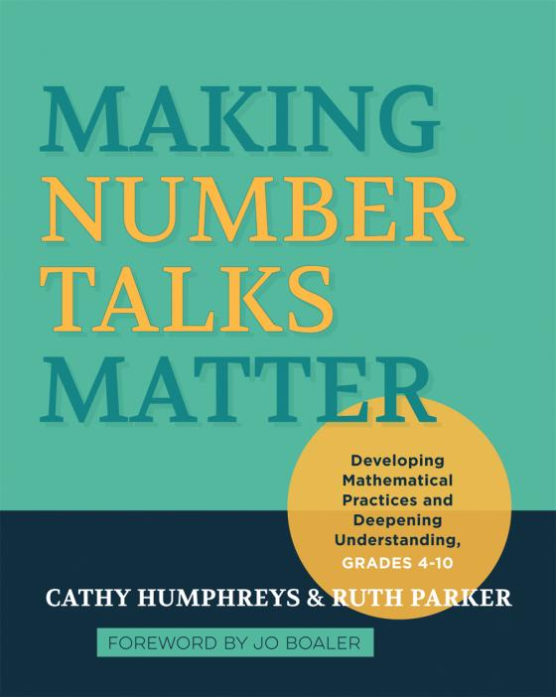
RESOURCES for Number Talks
Jo Boaler - youcubed.org

Slide 41
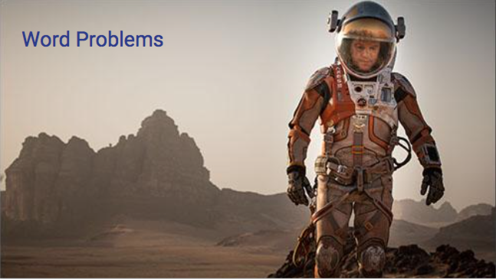

Slide 43
WORD PROBLEM ANALYSIS FORM
“The Form”
Notes:
Here is the form. With my students I model how to fill out the form, with a variety of problems. With you, I am going to let you go for it on your own, after I explain it briefly.
Student examples…
You have a few copies…..

Slide 45
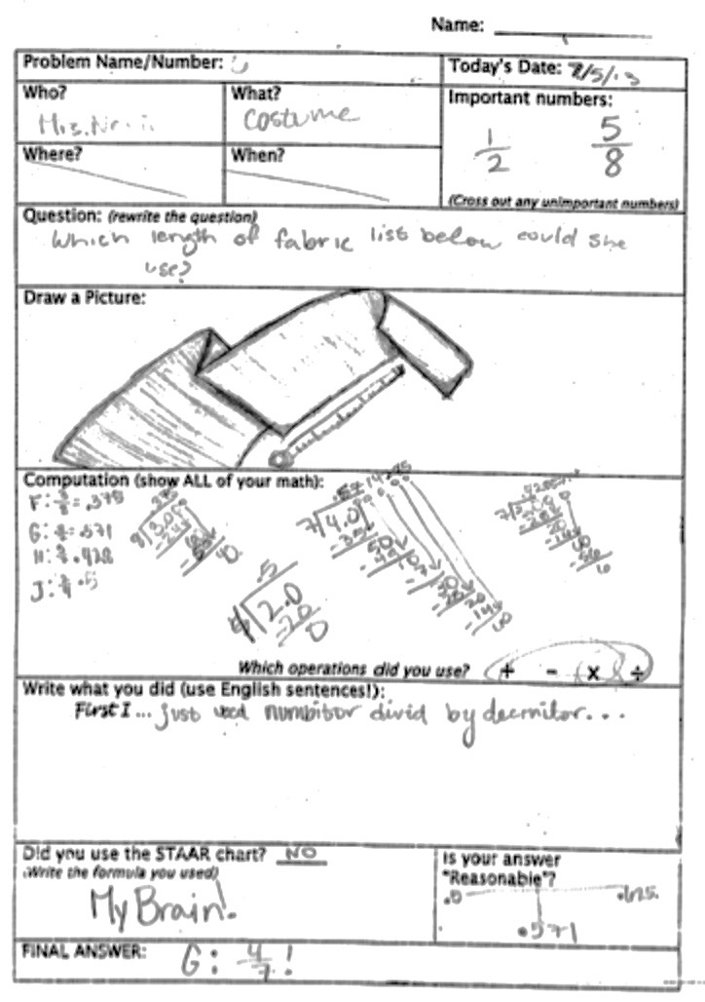

Slide 46
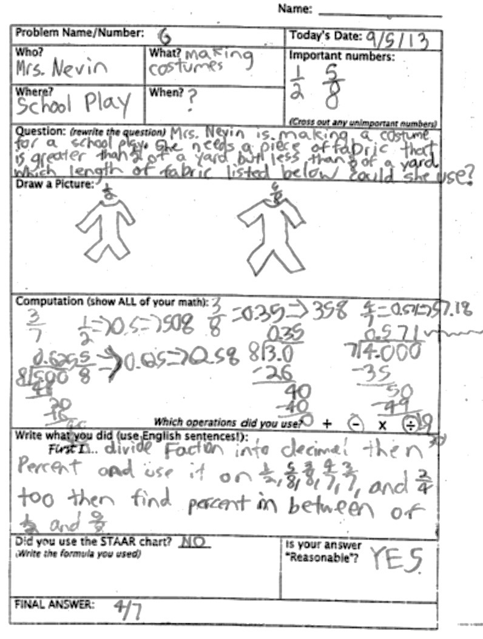

Slide 47
“THE FORM” – YOUR TURN!
Paula completely covered a square wall using 87.5 ft² of wallpaper without any overlap. Which measurement is closest to the side length of this wall in feet?
A. 22 ft C. 9 ft
B. 44 ft D. 7 ft
Notes:
Read problem aloud or sign – does that help?
What language can trip people up here?
Basically explain form, then expectations. Give 10-15 minutes, then questions/discussion at front.

Slide 48
WORD PROBLEM ANALYSIS FORM
Pros? Cons?
Can you see a use for this in your classroom? How? How not?
Will this help achieve our goal? How? Why? Not?
Notes:
After everyone has finished, discussion.
Pros: organizes thinking, multi-modes (numerical, pictoral, written)
Cons: takes time, students struggle with writing,
2 documents – pdf and doc – you can change the doc one to fit your needs.

Slide 49
PROCESS MOVIES
Process Movie – a movie in which students explain a mathematical process
FlipGrid – my new favorite app!
Other ideas - “Explain Everything” App, iMovie, etc.
Notes:
OK – enough writing….let’s do something else.
Process movies – short movie where students explain a process of doing something.
Don’t have to be adept at making movies.
VoiceThread Pricing K-12
Single Educator License $79/year or $15/month; 50 students
School License $450 for 350 students, and more
Pricing Higher Ed
Single Instructor License $99/year, 50 students
Department – look at site ☺

Slide 50
PROCESS MOVIES
Pros? Cons?
Can you see a use for this in your classroom? How? How not?
Will this help achieve our goal? How? Why? Not?
Notes:
Discussion

Slide 51
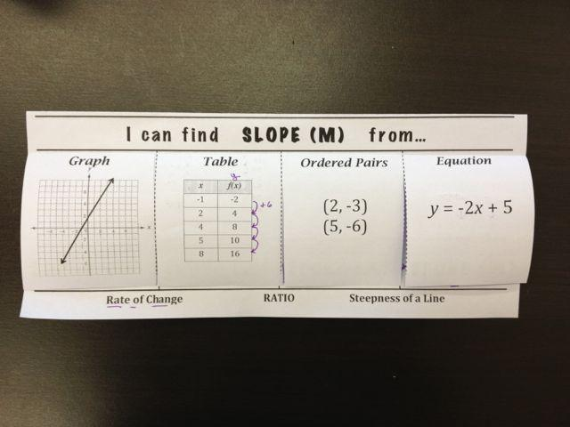
FOLDABLES
Bare bones – not really the right wording,…..
Notes:
When I was mentioning “Logistically” and “bare bones” this is one thing I think of.. FOLDABLES
Textbooks – OK, but these really pare it down.
Some on internet, some on TeachersPayTeachers, etc.

Slide 52
FOLDABLES
Notes:
When I was mentioning “Logistically” and “bare bones” this is one thing I think of.. FOLDABLES
Textbooks – OK, but these really pare it down.
Some on internet, some on TeachersPayTeachers, etc.

Slide 53
RESOURCES & WRAP UP
DeafTEC web site: deaftec.org
FaceBook page “Access Math for Teachers of D/HH Students and Others ”
Questions? Ideas?
Thank you!
dawn.kidd@tsd.state.tx.us

Slide 54
EXTRA information if time……..

Slide 55
ONLINE TUTORIALS
Gary Blatto-Vallee
National Technical Institute for the Deaf, Science & Math
Rochester Institute of Technology, Rochester, NY

Slide 56
ONLINE TUTORING
Many online resources
Videos (e.g. Kahn Academy, Video Math Tutor, teacher-made videos, etc.)
Benefits
Support “flipped” classroom
Provide extra help
Students can work at their own pace
Notes:
Anyone use a flipped classroom approach? Are your videos captioned?

Slide 57
ONLINE TUTORING
https://www.khanacademy.org/math/algebra/two-var-linear-equations/slope/v/positive-and-negative-slope
Link to Khan Academy
Notes:
EXPERIENCE: View video with sound off…
NOTE: It actually said “solve for y”

Slide 58
ISSUES
Issues with Online Resources
Captioning may or may not be available
Captioning may not be accurate
Pace and timing of multiple inputs can make video difficult to follow

Slide 59
WHY NOT USE GARY’S VIDEOS?
http://deaftec.org/resources/math/self-instruction/solving-xy-table
Let’s meet Gary, and see his list of videos
Link to Gary’s Videos
Notes:
GET VIDEO (and link) from DEAFTEC site

Slide 60
Benefits to Gary’s videos
Pace is slower
Voice/captions, and writing (solving) happen at separate times
Multi-modal – signed, voiced, captioned, and written algorithms

Slide 61
ASL MATH VIDEOS
Pros? Cons?
Can you see a use for this in your classroom? How? How not?
Will this help achieve our goal? How? Why? Not?

